Slide 1
Exploratory Data Analysis
Zach Edward Sai Lavanya Puthila
Notes:
We developed a research-oriented framework that integrates ingredient parsing with toxicogenomic evidence to evaluate additive prevalence and biological connectivity across packaged snack categories.

Slide 2
Research Problem
Processed snacks contain numerous chemical additives.
Consumers lack transparent biological-context risk signals.
Existing apps use heuristic scoring.
No open, reproducible integration of ingredient data with toxicogenomic evidence.

Slide 3
Objectives
Filter and structure real-world snack product data
Parse ingredient lists using NLP-style tokenization
Quantify additive prevalence by snack family
Integrate CTD disease connectivity evidence
Construct a transparent risk prioritization framework

Slide 4
Narrowed Scope
We restricted analysis to 3 snack families:
Chips & Savory Crisps
Cookies & Biscuits
Candy-Type Snacks
Focused on 3 representative additives:
Acesulfame Potassium (sweetener)
Sodium Benzoate (preservative)
Tartrazine / Yellow 5 (colorant)

Slide 5
Data Overview
Open Food Facts
~100,000 filtered products
Ingredient text + category tags
FDA FoodSubstances
Regulatory normalization – 50,000
CTD (Comparative Toxicogenomics Database)
Chemical dictionary – 40,000
Chemical–disease associations – 50,000

Slide 6
Data Cleaning
Handling Missing Values
Filtered out rows with missing ingredients_text (core analytical field)
Retained products with partial metadata (e.g., missing brands)
Treated additive flags as binary indicators (absence = 0)
Handling Missing Values
Filtered out rows with missing ingredients_text (core analytical field)
Retained products with partial metadata (e.g., missing brands)
Treated additive flags as binary indicators (absence = 0)
Handling Inconsistencies
Standardized text to lowercase
Removed parentheses and special characters
Tokenized ingredients by comma separation
Normalized chemical names using FDA reference set

Slide 7
Feature Engineering
ingredient_count → proxy for formulation complexity
Binary additive flags (regex-based entity detection)
CTD evidence weight:
weight=log(1+disease_count)
Risk normalization by ingredient count
Notes:
We cleaned ingredient text through normalization and tokenization to enable structured analysis. Duplicates were removed to prevent statistical distortion. We engineered formulation complexity and additive presence features, then integrated toxicogenomic evidence into a log-scaled risk weight. This transforms raw ingredient text into structured, analyzable signals.

Slide 8
Filtering & Cleaning
Initial subset: 100,020
After deduplication: 99,893
Missing ingredient rows removed
Category distribution:
Cookies & Biscuits: 73,140
Chips & Savory: 21,216
Candy Snacks: 5,537
Notes:
We removed duplicates to avoid frequency distortion and ensured ingredient text was present for all products analyzed.

Slide 9
Ingredient Parsing
Regex-based cleaning
Parentheses removed
Tokens split by commas
Ingredient count calculated
Ingredient Complexity (Mean Count):
Cookies & Biscuits ≈ 14
Candy Snacks ≈ 9.9
Chips & Savory ≈ 8.4
Notes:
Ingredient count serves as a proxy for formulation complexity. Structural baked goods show higher complexity than savory snacks. Regex-based cleaning involves using regular expressions to identify, validate, and transform data in a structured and efficient manner. This method is particularly useful for tasks such as pattern matching, data validation, and data transformation. Regex can be employed to remove unwanted characters, correct formatting errors, and ensure that data conforms to expected formats. It is a powerful tool for enhancing data quality and improving the reliability of subsequent analyses.

Slide 10
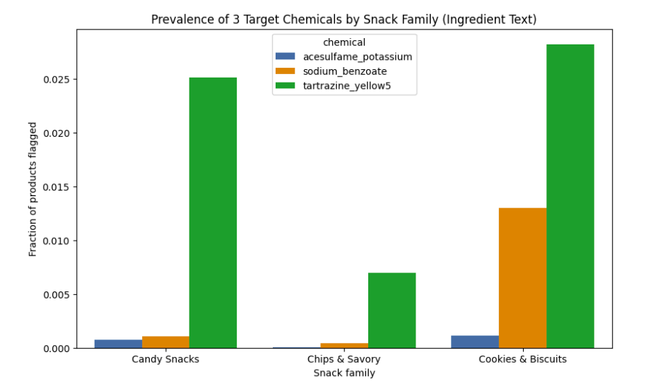
Target Additive Prevalence
Prevalence by Snack Family:
Tartrazine:
Cookies: ~2.8%
Candy: ~2.5%
Chips: ~0.7%
Sodium Benzoate:
Cookies highest
Acesulfame Potassium:
Rare across all
Notes:
Additive presence varies systematically by snack ecosystem, confirming that ingredient profiling differentiates product types.

Slide 11
FDA Integration
Purpose of FDA dataset:
Regulatory validation
Name normalization baseline
Synonym reference
Notes:
FDA was used as a validation layer to ensure the additives analyzed exist in formal regulatory documentation.

Slide 12
CTD Evidence Integration
CTD Weight Definition:
disease_count = unique diseases linked to chemical weight = log(1 + disease_count)
This represents:
Breadth of documented toxicogenomic interaction
Research connectivity
Mechanistic diversity
Notes:
CTD Weight Definition:
disease_count = unique diseases linked to chemical weight = log(1 + disease_count)
This represents:
Breadth of documented toxicogenomic interaction
Research connectivity
Mechanistic diversity
Important: NOT a toxicity classification NOT proof of causation

Slide 13
Risk Score Construction
For each product:
Risk_raw =(ace_flag × w_ace) +(ben_flag × w_ben) +(tar_flag × w_tar)
Normalized by ingredient count.
Notes:
This prevents long ingredient lists from inflating risk unfairly.

Slide 14
CTD Integration Limitation
Milestone Limitation:
CTD header irregularities
Partial slice loading
Synonym resolution incomplete
Result: Risk weights returned zero in capped milestone slice.
Notes:
The integration pipeline is validated structurally, but full CTD parsing requires complete dataset indexing and expanded alias mapping.
Transparency earns credibility.

Slide 15
Statistical Testing
Kruskal–Wallis Test: Not meaningful due to zero-weight constraint in milestone slice.
Notes:
The Kruskal-Wallis test is a nonparametric statistical test used to determine whether there are significant differences between the medians of three or more independent groups.

Slide 16
Exploratory Data Analysis (EDA)
Univariate Analysis
Ingredient formulation complexity (ingredient_count distribution)
Additive prevalence (Acesulfame K, Sodium Benzoate, Tartrazine)
Missingness assessment across key variables
Purpose: Establish baseline structure, validate data quality, and quantify formulation differences within snack ecosystems.
Multivariate Analysis
Ingredient complexity differences across snack families (Kruskal–Wallis test)
Additive prevalence patterns by category
Construction of evidence-weighted CTD risk signal
Category-level comparison of additive burden
Purpose: Move from descriptive profiling to category-aware differentiation and biological-context prioritization.
.
Notes:
We first performed univariate analysis to understand ingredient complexity and additive prevalence independently. We then extended this into multivariate analysis by comparing snack families statistically and integrating toxicogenomic evidence to construct a biologically contextualized risk framework.

Slide 17
Limitations
Regex-based entity recognition
Limited additive set (3 chemicals)
Partial CTD parsing
No dosage modeling
Notes:
The Kruskal-Wallis test is a nonparametric statistical test used to determine whether there are significant differences between the medians of three or more independent groups.

Slide 18
Future Work
Full CTD indexing Systematic E-number → chemical mapping Expanded additive set Ingredient embeddings + clustering Predictive modeling (logistic regression / tree-based models) Integrate nutrient covariates (salt, sugar, fat)

Slide 19
Question’s
.
Notes:
“What is your dependent variable?”
Answer:
Category-level additive prevalence and evidence-weighted additive burden.

